Slide 1
PYTHON CHART PLOTTING

Slide 2

Importing File’s :
import os
import numpy as np
import pandas as pd
from matplotlib import pyplot as plt
import seaborn as sns

Slide 3

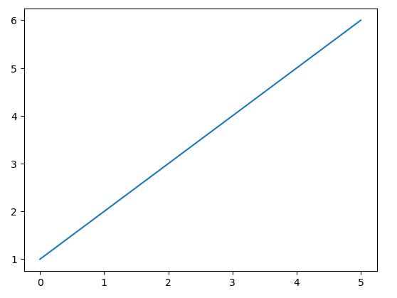
Plotting Graph :

Slide 4
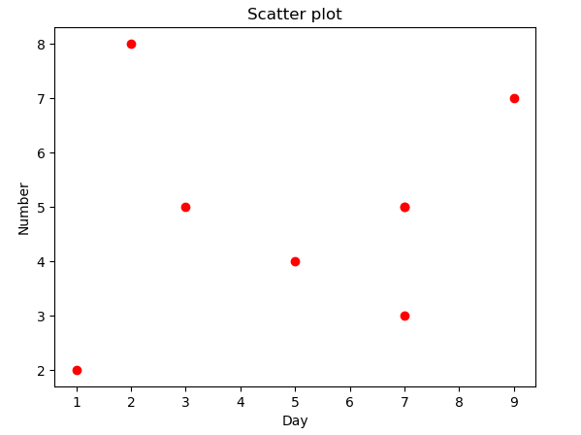
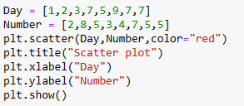
Plotting Scatter on Graph :

Slide 5
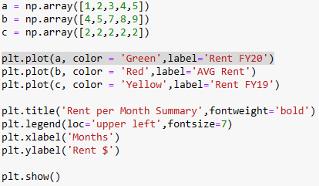
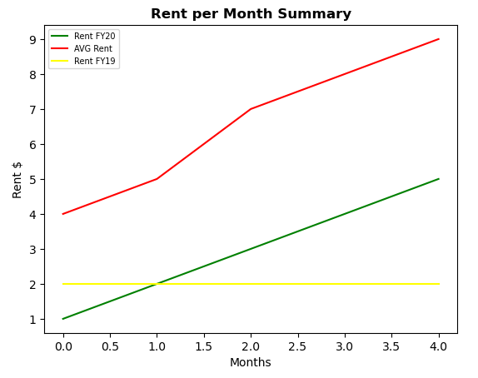
Line Graph :

Slide 6
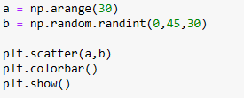
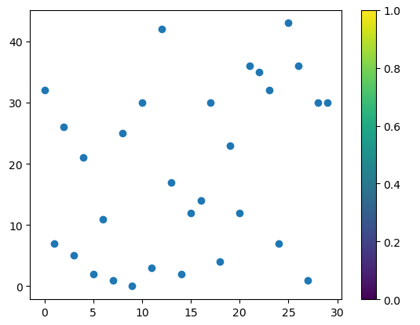
Scatter graph with Bar :

Slide 7

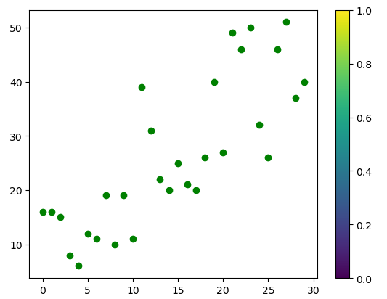
Scatter graph adding two axis:

Slide 8

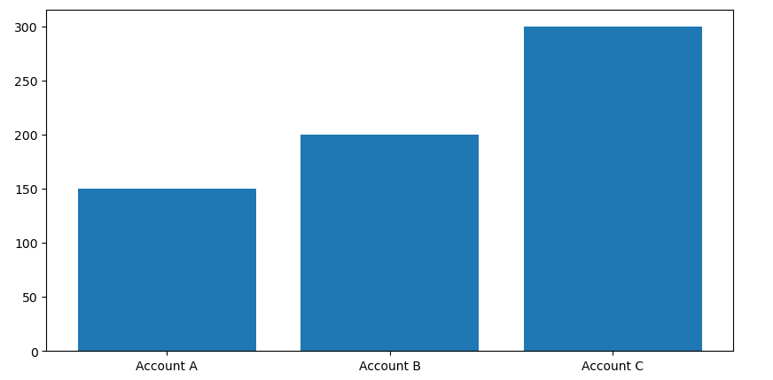
Histogram :

Slide 9
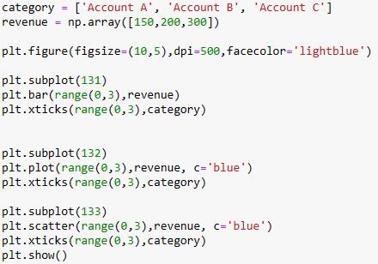
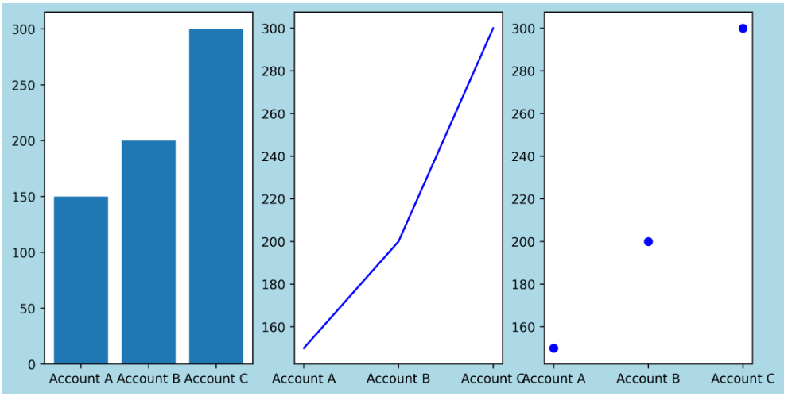
Subploting of Graphs :

Slide 10
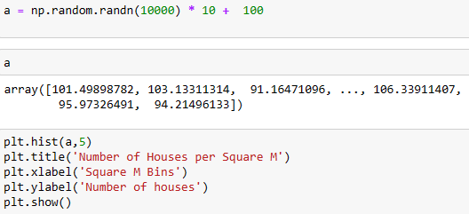
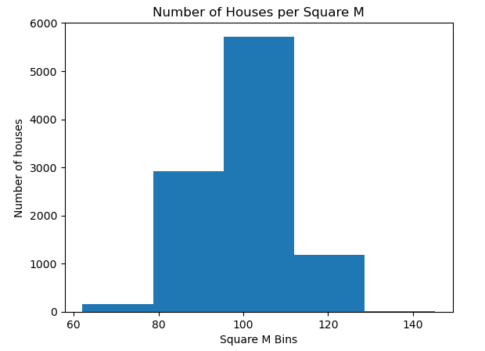
Histogram Graphs :

